Slide 1
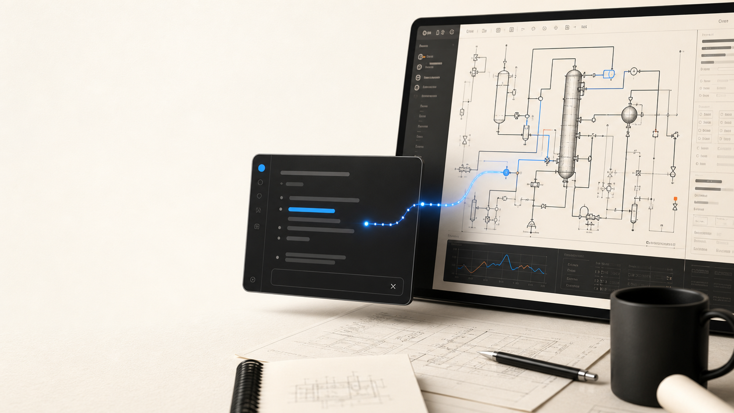
REFLUX
PITCH DECK
The Cursor for
chemical engineers.
Reflux turns plain-language engineering intent into reviewed simulator actions.
TYPE -> REVIEW -> RUN
01

Slide 2

REFLUX
MEET DAVE
Dave is a
chemical engineer.
He's depressed.
Because the tools make the work feel slower, more fragile, and more confusing than it should.
02

Slide 3
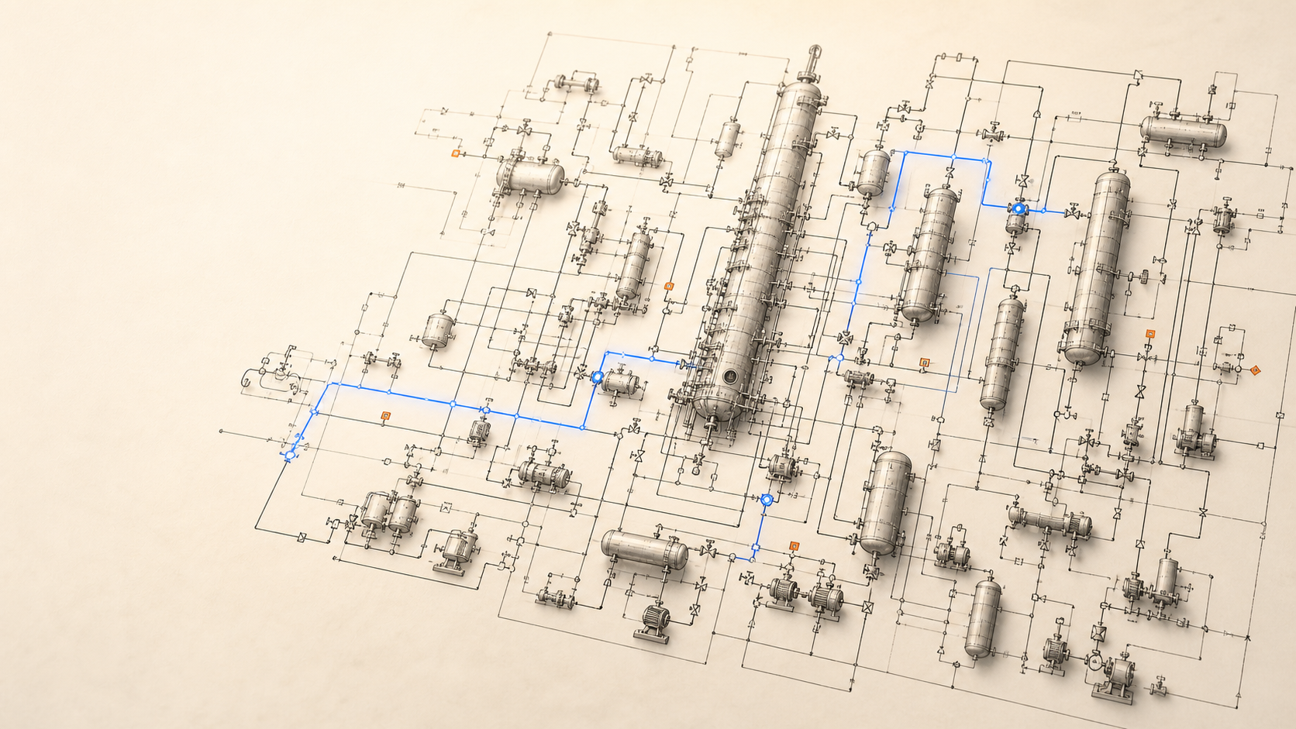
REFLUX
FLOWSHEETS
This is what a flowsheet looks like.
It's a living graph of equipment, chemistry, constraints, and recycle loops.
03

Slide 4

REFLUX
MANUAL WORK
Building and simulating these flowsheets is still manual.
Time consuming. Tedious. Dependent on software from the 1980s.
04

Slide 5
REFLUX
STATUS QUO
Slow.
Unreliable.
Throws errors all the time.
The software is not just old. It becomes the bottleneck.
05

Slide 6

REFLUX
TRIAL AND ERROR
Dave stops engineering
and starts guessing.
Change a spec. Rerun. Read a cryptic error. Guess again.
06

Slide 7
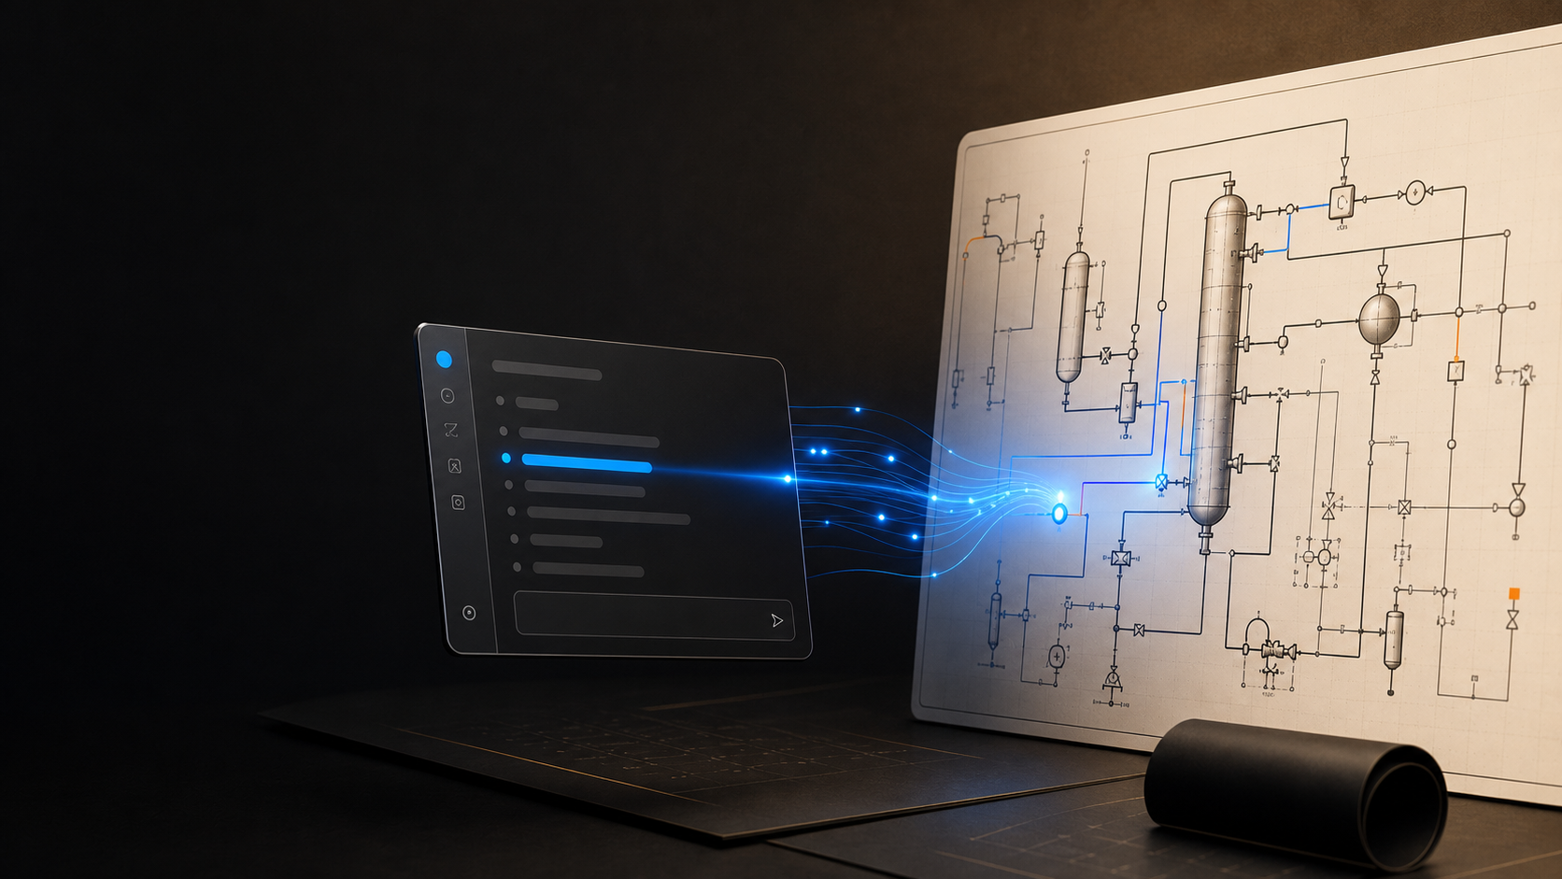
REFLUX
This is why
I built Reflux.
The interface should understand the flowsheet Dave is trying to create, then operate the old software for him.
07

Slide 8
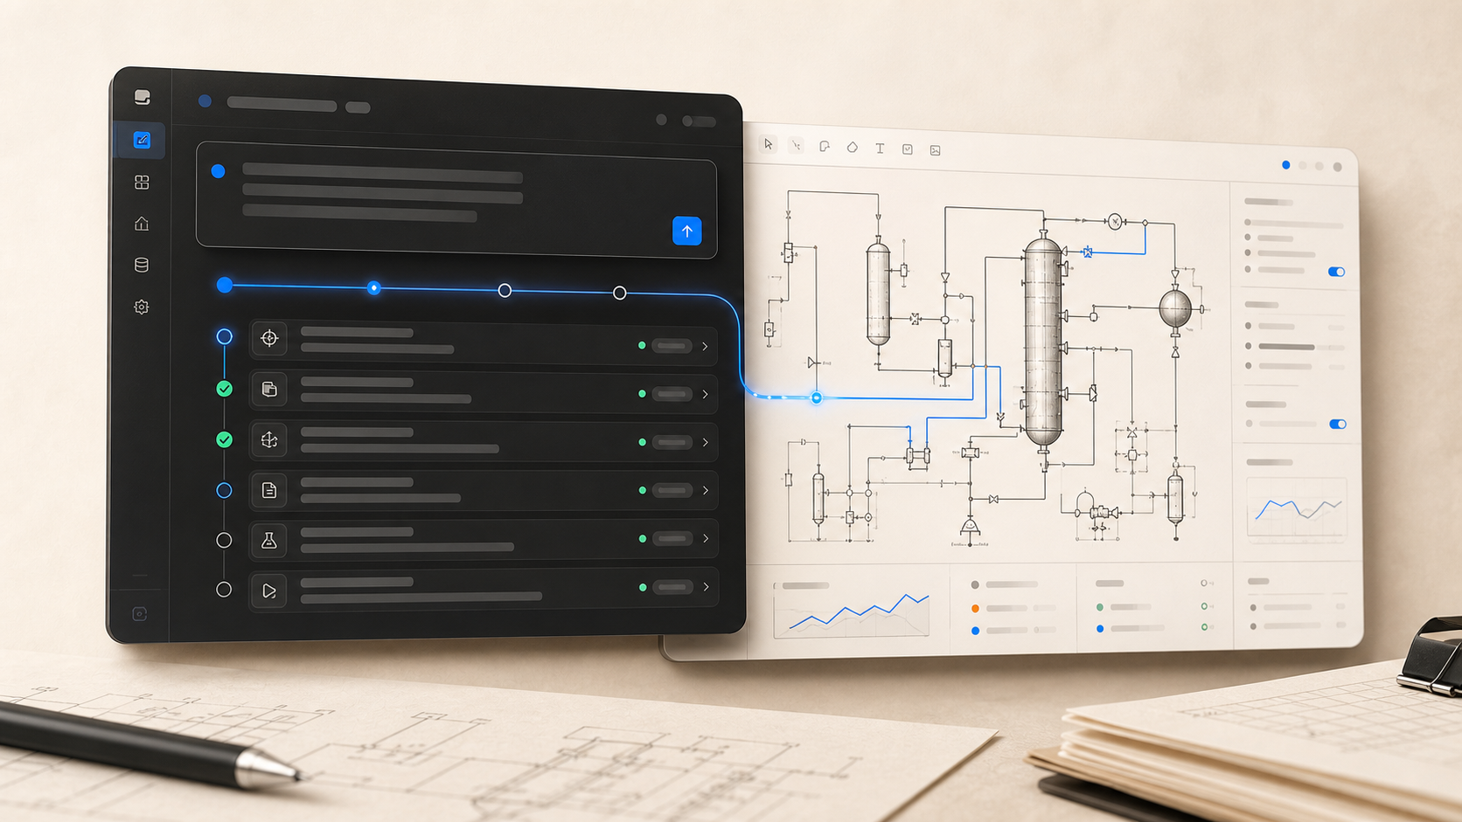
REFLUX
COMMAND SURFACE
All Dave has to do is type what he wants.
Create a flowsheet. Make an edit. Run it.
The Cursor for chemical engineers
08

Slide 9
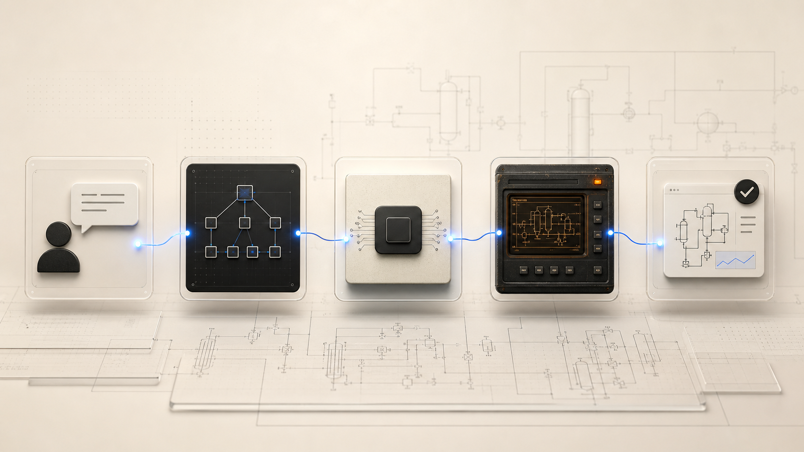
REFLUX
ADAPTER LAYER
Reflux connects to the old software and makes it work.
Intent -> plan -> simulator adapter -> reviewed result.
09

Slide 10
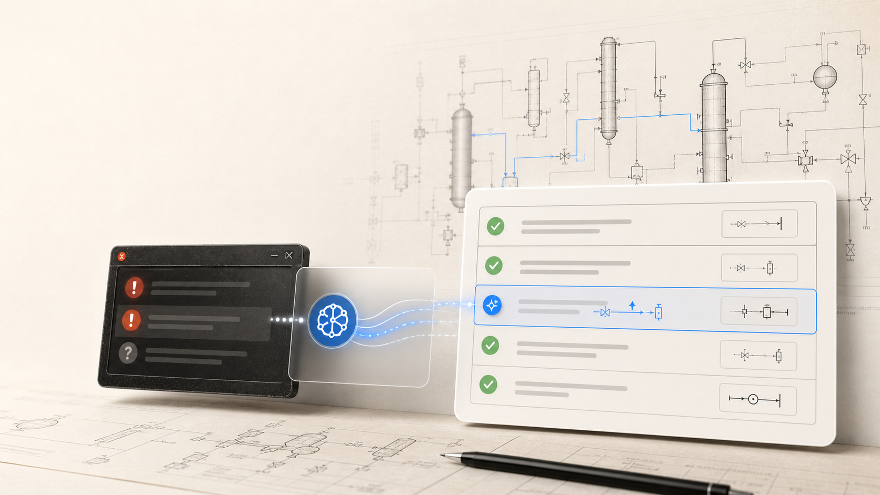
REFLUX
GUARDRAILS
No more errors that won't go away.
No more missing important flowsheet pieces.
10

Slide 11

REFLUX
OUTCOME
Dave gets hours of his day, and tens of hours of his week, back.
Less retrying. More engineering.
TRY REFLUX TODAY
11

